Slide 1

RAD, Hopewell and C’ville
Public Housing Association of Residents (PHAR)
What have we learned?

Slide 2
Who, What, When, Where
PHAR Interns- Sabrina, Mary, Christine, Jamika
PHAR Board members- Joy, Shymora, Latita
PHAR Staff- Brandon, DeeDee, Karen
Trip to Hopewell
January 10, 2014
Langston Park (public housing)
Hopewell Redevelopment and Housing Authority (HRHA) Administrative Office

Slide 3


Slide 4
Why?
Meet with Residents
Meet with HRHA Staff
Learn about RAD in Hopewell
Effects on Residents
Compare to CRHA
Educate PHAR and Residents

Slide 5
How?
Intern Organizing Goals
- Learn Effects of RAD on Other Communities
- Learn More about RAD
- Share Knowledge with Residents and PHAR
- Exchange Info with Other Resident Groups
Interns Crafted Itinerary
Interns Crafted Discussion Points and Agenda

Slide 6
Activities
Visited Langston Park
Walked the Site
Met Residents Inside and Outside of Homes
Meeting with HRHA Executive Director
Steven Benham and Public Housing Director Madelyne Madison-Hyde
Took Notes!

Slide 7
Overview of HRHA and RAD
Number of units- 490
Applied for RAD in October 2013
Langston Park Approved
Kippax Denied
Conversion to happen the next week
Breaking Ground in March 2014
Langston built in 1962
Crumbling, Roach Infested
No RAB for Langston, Kippax has Tenants Assoc.

Slide 8
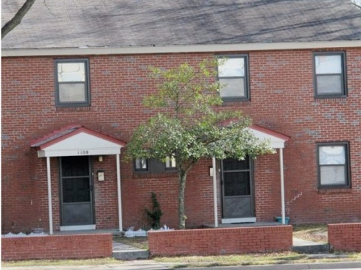
Langston Park
Front View

Slide 9
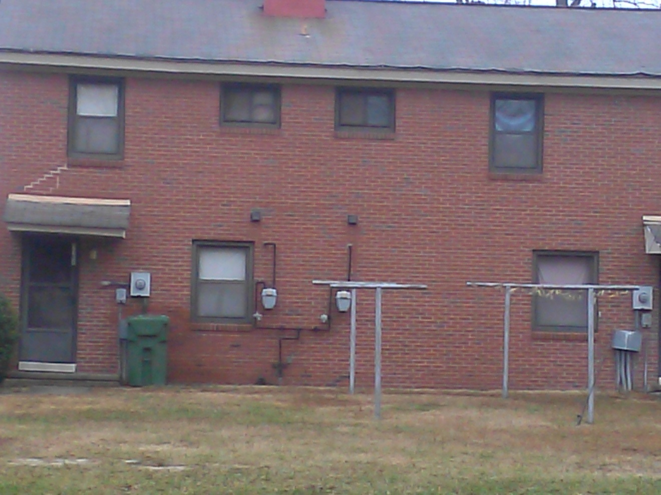
Langston Park
Back view

Slide 10
Different Perspectives
Residents and HRHA had different perspectives!
Especially Resident Engagement
Residents hesitant to speak
Residents unaware of “RAD”, but knew the change was coming
Residents concerned about crackdown on lease violations
Poor relationship with HRHA staff

Slide 11
Different Perpectives Cont’d
Residents
HRHA
Unaware of “RAD”
Some unaware of Conversion and new Property Management/Owners
Unaware of Resident Meetings on RAD
Concerned about Relocation
Lots of Outreach
Meetings with new Management Company
Well attended meetings, only focused on physical changes not conversion
One on One relocation plan

Slide 12
Comparisons to Charlottesville
PROCESS
HRHA- Hopewell
CRHA- Charlottesville
Began Discussion and Planning for Redevelopment in 2009
Dedicated Staff for Redevelopment
Financing Options Explored (applied for and denied Choice Neighborhood)
RAD was good timing, had tried other options, needed something like RAD
Decisions about financing mostly flushed out
Master Plan for Redevelopment in 2009
No current Redevelopment Staff
Financing Options a Mystery
RAD timing a surprise, is only option being considered
Decisions on how to use RAD mostly to be determined

Slide 13
Comparisons to Charlottesville PROCESS cont’d
HRHA- Hopewell
CRHA- Charlottesville
Applied for first round, approved for Langston, Kippax denied
Ongoing engagement with business community
Residents involved after board approval
Resident meetings with developer focused on physical aspects
No application
Business community may or may not be involved
Residents involved resulting in no board approval
Resident meetings with CRHA focus on explaining conversion

Slide 14
Comparisons to Charlottesville RESIDENTS
HRHA- Hopewell
CRHA- Charlottesville
Fearful of speaking up
Staff controlled by ED
Fearful of eviction before conversion
Lack of maintenance response
Unaware of “RAD”
See need for redevelopment (crumbling, roaches, streets, busted)
Some speaking up
Staff controlled by ED
Fearful of losing homes after conversion
Lack of maintenance response
Aware of RAD, but confused
See need for upgrades (not as bad as Hopewell, improvements needed)

Slide 15
Comparisons to Charlottesville
MEETING with HRHA
HRHA- Hopewell
CRHA- Charlottesville
ED chosen to do Redvelopment
RAD chosen after Choice Neighborhood turned down
Property “functionally obsolete”
Conversations with non-profit to advise on RAD
Community Housing Partners
RAD fits Hopewell
ED Chosen for multi-family experience
No other options explored
In bad shape, not functionally obsolete (?)
Redevelopment committee abandoned, CDC still waiting to be formed
Community Housing Partners has advised some
Does RAD fit Charlottesville?

Slide 16
Comparisons to Charlottesville
DECISIONS, DECISIONS
HRHA- Hopewell
CRHA- Charlottesville
PBV
Retain role as inspectors
Partner with non-profit, ownership to developer
Physical Needs Assessment has Langston as #1
Tax Credits denied for Kippax Place
Will reapply for all units
No decisions made!!!
Leaning towards PBV
Says wants to retain ownership
Wants to do Crescent Halls first
Unclear on if able to access tax credits
Plans to apply for all 376

Slide 17
Comparisons to Charlottesville
DECISIONS, DECISIONS
HRHA- Hopewell
CRHA- Hopewell
Board approval not unanimous
Politics involved
No comment on opposition concerns
Board unable to find majority to approve in 2013
Board not well informed and PHAR is involved

Slide 18
Comparisons to Charlottesville
City Involvement
HRHA- Hopewell
CRHA- Charlottesville
City Supports, but not involved
Need City support for tax credits
City doesn’t provide funding
City owns vacant lots
Hopewell community divided on need for public housing
Trying to get City involvement
Tax credits conversation not happening yet
City possibly provide some funding
CRHA has vacant lots
Charlottesville community largely unaware of public housing issues

Slide 19
IMPACTS
Langston fully funded for redevelopment
Staff will change, seeking trainings and certifications so current staff can work with new management
Additional 26 units of market rate (50% of AMI) added to Langston
No significant lease changes
“Not too concerned” about waiting list impacts- lists not that big
Working through selection criteria and admissions*
Residents can organize under Section 8, Community Housing Partners still has to follow the rules

Slide 20
IMPACTS cont’d
Relocation Plan submitted in late November*
Residents need to be involved in relocation
One on one meetings to craft individual relocation plans
All 30 have right to return*
Plan to apply for remaining sites
Break ground in March

Slide 21
What Does this Mean?
PHAR is doing great! Thankful we have resident organizing
CRHA property in better shape than HRHA
HRHA has thought through Redevelopment thoroughly and knows what it is doing
Residents in C’ville better informed than in Hopewell
RAD approval is competitive! Physical Needs Assessment and Tax Credits have different criteria- CRHA may not get approval.
If funders aren’t under contract after preliminary approval in 6 months then RAD will be denied.
Adding mixed-income and market rate is the only way to get enough funding- conversion alone won’t cover the cost.

Slide 22
Results of RAD in Hopewell
Still too early to tell
Staff changes and staff training
Market Rate added
Residents fearful and confused
HRHA has team working on redevelopment

Slide 23
Next Steps
PHAR follow up visit in the Summer?
Connect with other RAD sites in Virginia
Identify Resident Leaders
Possible Statewide Resident organizing and Coordination
HRHA will apply for all sites
Find CRHA Physical Needs Assessment

Slide 24

Questions ???

